Slide 1


Development of Blockchain-based Framework for Certificate Verification and Fraud Prevention
Thesis Pre-Defense – Fall 2024
22 January 2025
Presented by-
Md. Dulal Hossain – 213902116
Md. Rabby Khan – 213902037
Mostak Ahmed – 213902126
Supervisors-
Dr. Md Ahsan Habib, Professor
Sudip Ghoshal, Lecturer
Department of Computer Science and Engineering
Green University of Bangladesh

Slide 2


Table of Contents
Introduction
What is Blockchain?
Blockchain Block Process
Problem Statement
Related Works
Motivation
Objective
Proposed Architecture
Sequence Diagram
Methodology
Grant Chart
Budget Plan
Implementation
Conclusion
Reference
01

Slide 3
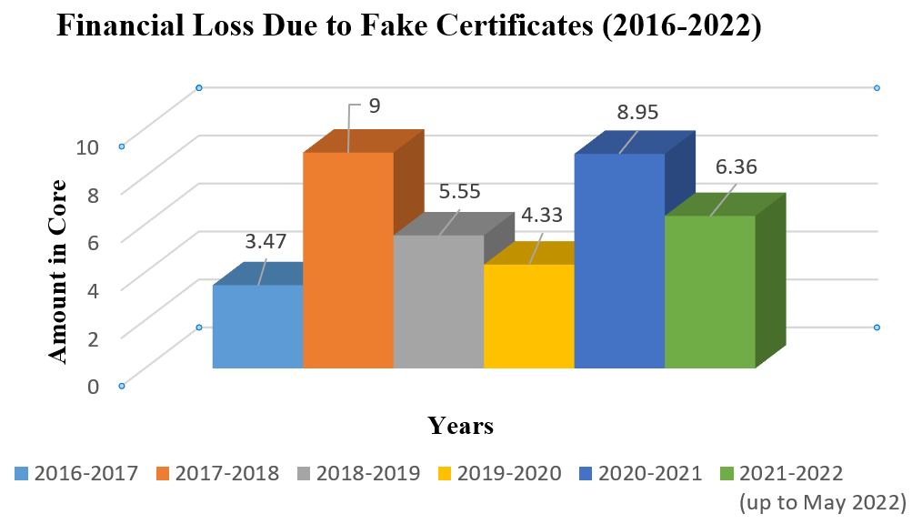
Introduction
In today's swiftly evolving digital era, the need for secure, efficient, and reliable methods of certificate generation and validation has escalated significantly. In Bangladesh, as in many countries, the current certificate issuance and verification systems face challenges such as fraud, forgery, and inefficiencies due to manual processes.
Rapid digitalization increases fraud risks, emphasizing the need for secure and reliable systems.
Technologies like Blockchain, AI, and IoT improve transparency, fraud detection, and integration.
Utilizing 4IR technologies ensures a secure, resilient, and trustworthy digital future.
Source: https://thenewstimesbd.com/
02

Slide 4

What is Blockchain?
Block n
A blockchain is a distributed database that maintains a keep-growing list of ordered records called blocks.
Header
Header: Combine all the above elements.
Timestamp: Add block creation time.
Previous Hash: Link with the prior block's hash.
Data: Input transaction or block data.
Hash: Apply SHA-256 to generate a unique block hash.
Nonce: Use for proof-of-work adjustments.
Merkle Root: Summarize all transactions.
Timestamp
Previous Hash
Data
Hash Calculated
Nonce
Merkel Root
03

Slide 5
Blockchain Block Process
Block No. 01
Block No. 02
Block No. 03
Data
Data
Data
Timestamp
Timestamp
Timestamp
Previous Hash:
0000D8C42
Previous Hash:
00003A459
Previous Hash: 0000
…
…
Hash: 0000D8C42
Hash: 00003A459
Hash: 00003D45F
Genesis Block
SHA 256
Function
SHA 256
Function
00003A459
00003D45F
04

Slide 6
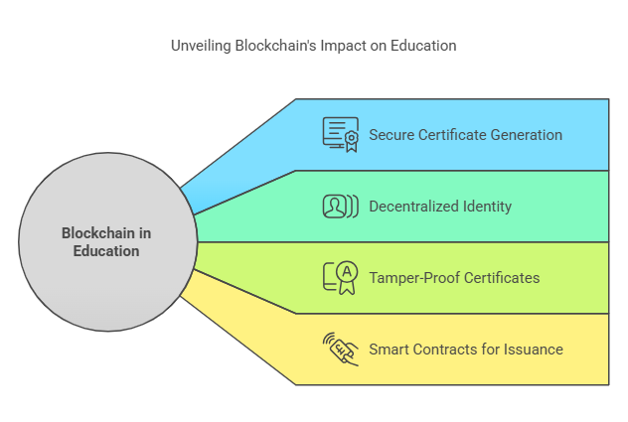
Applications of Blockchian
Blockchain Technology in Education
Secures and streamlines certificate generation and validation processes.
Decentralized and Self-Sovereign Identity
It enables individuals to control their digital credentials using blockchain.
Tamper-Proof Certificates
Blockchain's immutability ensures secure and unalterable educational credentials.
Smart Contracts for Certificate Issuance
Automates certificate issuance based on predefined criteria.
05

Slide 7
Problem Statement
How can organizations effectively prevent certificate forgery and ensure the integrity of issued certificates?
What methods can organizations implement to streamline the verification process and ensure authenticity with minimal manual intervention?
How can 4IR or advanced technologies like blockchain be used for real-time, accurate certificate verification?
How can Blockchain technology be effectively utilized to build a resilient and trustworthy digital ecosystem?
06

Slide 8
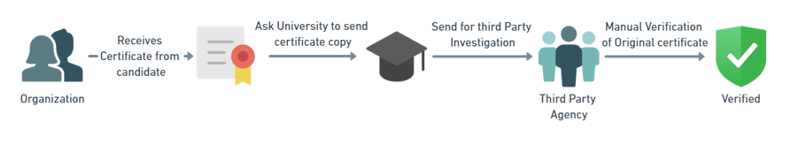
Related Work
In Bangladesh certificate verification has two ways:
Traditional Methods:
Manual verification, Physical submission.
Universities: GUB, DU, BUET.
Online Methods:
Web Search using a Database or API.
Universities: BUP, Stamford, NUB.
Limitations:
Traditional Methods:
Time-consuming.
Prone to human errors.
Online Methods:
Technical challenges (server issues, cyber-attacks).
Digital divide (access and skills).
High implementation costs.
07

Slide 9
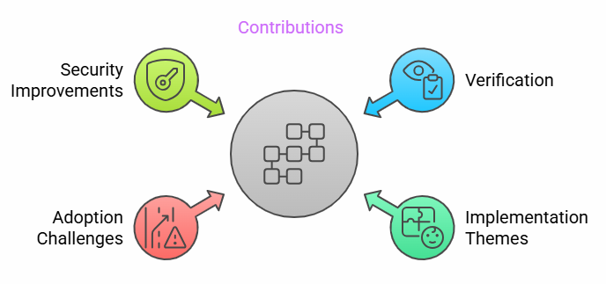
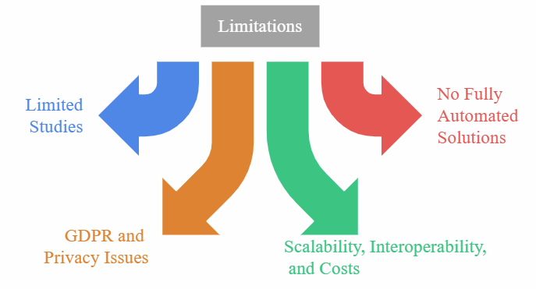
Related Work (1/2)
A Systematic Literature Review on Blockchain-Based Systems for Academic Certificate Verification [1]
Introduction: This study reviews blockchain-based academic certificate verification, identifying research gaps, themes, and future directions for education enhancement.
Contributions:
Blockchain for certificate verification.
Six implementation themes.
Adoption challenges.
Gradual adoption and security improvements.
Limitations:
Limited studies in education.
No fully automated solutions.
GDPR(General Data Protection Regulation ) and privacy issues.
Scalability, interoperability, and costs.
08

Slide 10
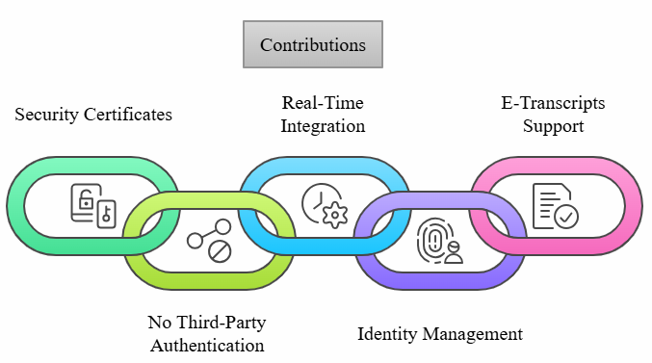
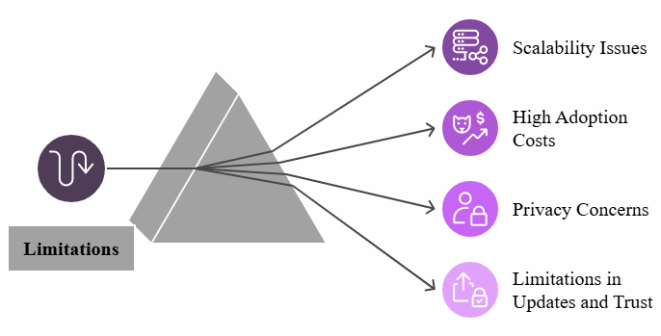
Related Work (2/2)
Blockchain & IoT for Educational Certificates Generation & Verification. [2]
Introduction: Blockchain and IoT revolutionize education by enabling secure, decentralized certificate verification, ensuring authenticity, data integrity, and privacy.
Contributions:
Blockchain-IoT framework for secure certificates.
No third-party authentication.
Real-time IoT integration to prevent counterfeiting.
Supports identity management and e-transcripts.
Limitations:
Scalability issues.
High adoption costs.
Privacy concerns.
Limitations in updates & trust.
09

Slide 11

Related Work
Research Name | Contributions | Limitations
Blockchain-Based IoT Access Control System Towards Security, Lightweight, and Cross-Domain (2021) [3] | Lightweight IoT control. Scalable blockchain. Secure cross-domain. DDoS protection. Dynamic PDP. | Scalability issues. Latency impact. High energy use. Blockchain overhead. Integration complexity.
Blockchain-Based AI-Enabled Industry 4.0 CPS Protection Against Advanced Persistent Threats (2023) [4] | Combines blockchain, AI, and edge solutions. Focuses on APT protection for IoT and storage. Decentralized, lightweight approach. | Edge vulnerabilities not fully addressed. Complex AI models for edge devices. Blockchain and AI integration challenges.
A Decentralized Lightweight Blockchain-Based Authentication Mechanism for IoT Systems (2022) [5] | Decentralized authentication. Proof-of-concept demo. Comparison with existing methods. | Scalability. Ethereum dependency. Synchronization overhead. Power consumption.
10

Slide 12
Motivation
Interest in Technology: Fascination with blockchain decentralized and secure ledger technology.
Enhance the trustworthiness of certificates.
Ensure secure, automated processes.
Enable seamless, standardized global recognition.
Speedup to Verification: Traditional methods require a minimum of 2 days, while our system completes the process in less than an hour.
Increasing Incidence of Credential Fraud: The prevalence of fraudulent academic credentials poses a significant threat to the integrity of educational systems worldwide.
Limitations of Current Verification Processes: Existing verification processes often rely on centralized databases and manual checks.
11

Slide 13
Objective
To enhance document security by preventing unauthorized access and forgery.
To simplify certificate issuance using the Ethereal blockchain.
To streamline verification with unique URLs or QR codes.
To ensure transparency by logging activities on the blockchain.
To prevent fraudulent claims with a secure system.
12

Slide 14
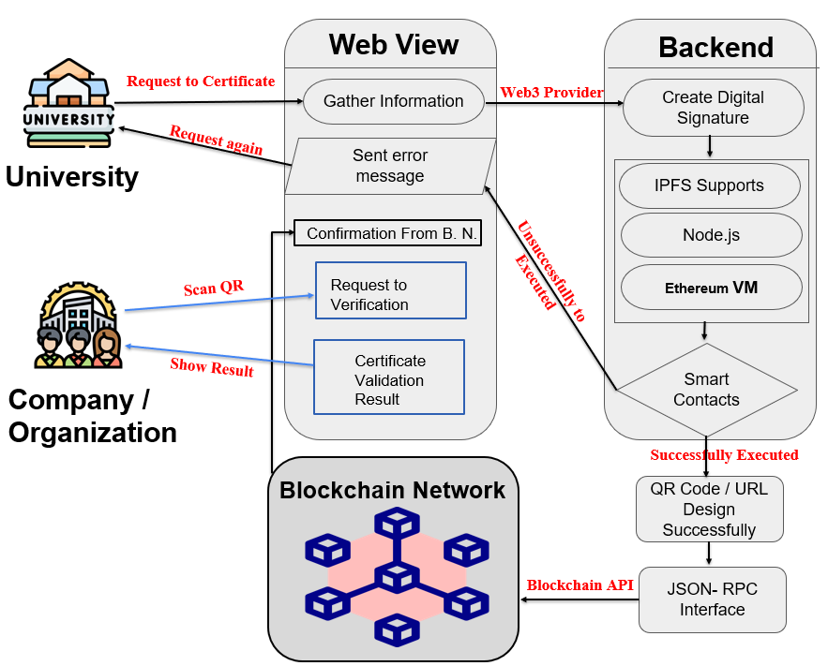
Proposed Architecture
13

Slide 15
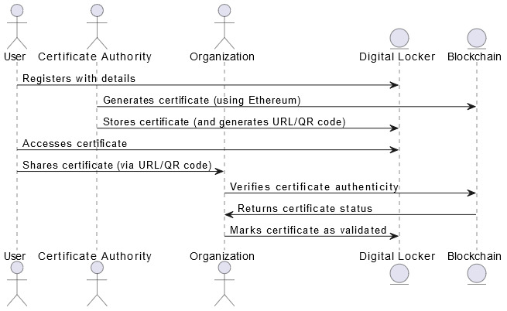
Sequence Diagram
14

Slide 16
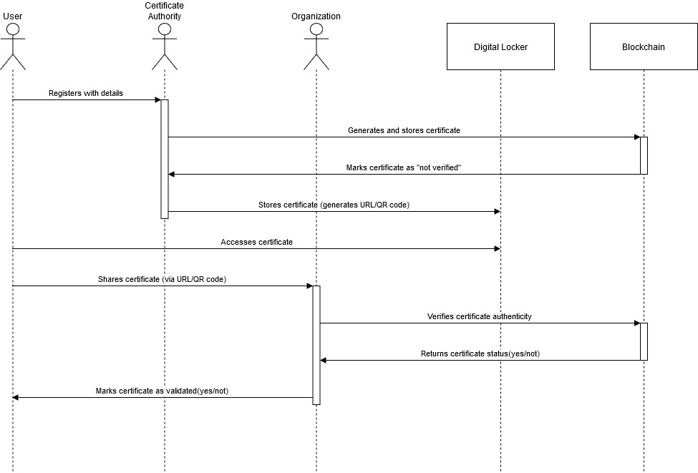
Sequence Diagram
14

Slide 17
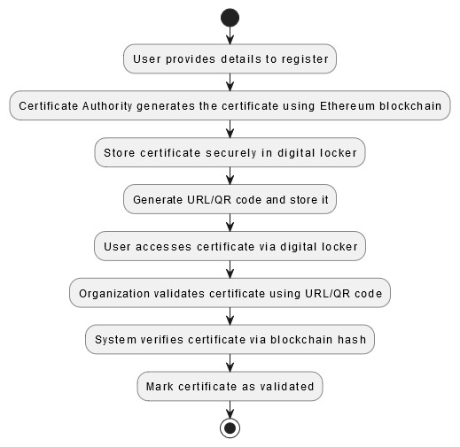
Methodology
15

Slide 18
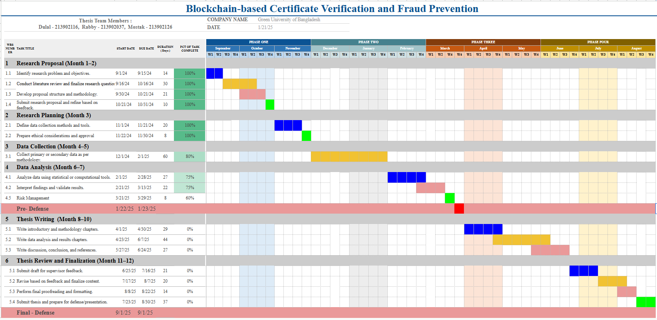
Grant Chart
16

Slide 19
Budget Table
Points | Item | Unit | No. of Unit | Per Unit Cost (Tk) | Duration (Month) | Total Cost (BDT-Tk)
01 | Data Collection | Travel & Testing | 10 | 5,000 | 12 | 50,000
02 | Blockchain Setup | Cloud-based blockchain nodes (AWS / Azure) | 12 | 10,000 | 12 | 1,20,000
03 | Hardware | Laptop & IoT Devices | 2 | 80,000 | ------ | 1,60,000
04 | Publication | Conference / Journal Fees | 2 | --------- | ------ | 1,00,000
05 | Software Tools | Dev Tools ( Colab Pro ) | 12 | 1,500 | 12 | 18,000
06 | Hosting & Domain | Hosting for certificate verification portal | 1 | 12,000 | 12 | 12,000
07 | Miscellaneous | General Expenses (Print) | -------- | 1,000 | 12 | 12,000
Total |  |  |  |  |  | 4,72,000
17

Slide 20
Implementation (1/2)
Initialize Blockchain: Load or create blockchain.
Save Certificate: User selects file, generates digital signature, adds data to blockchain, and mines a block.
Verification Certificate: User selects file, checks its signature against blockchain, and displays result.
Proof of Work: Adjust nonce to meet difficulty in hashing.
Exit: Close the app.
Tools: | Techniques:
Python language | Blockchain
Tkinter | Digital Signature
Hashlib | Certificate Verification
Pickle | GUI
18

Slide 21
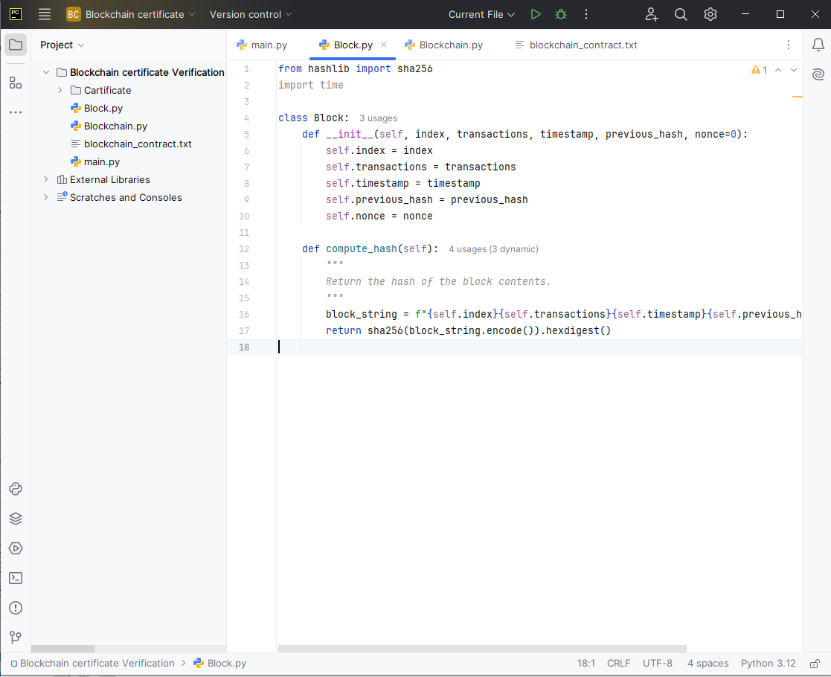
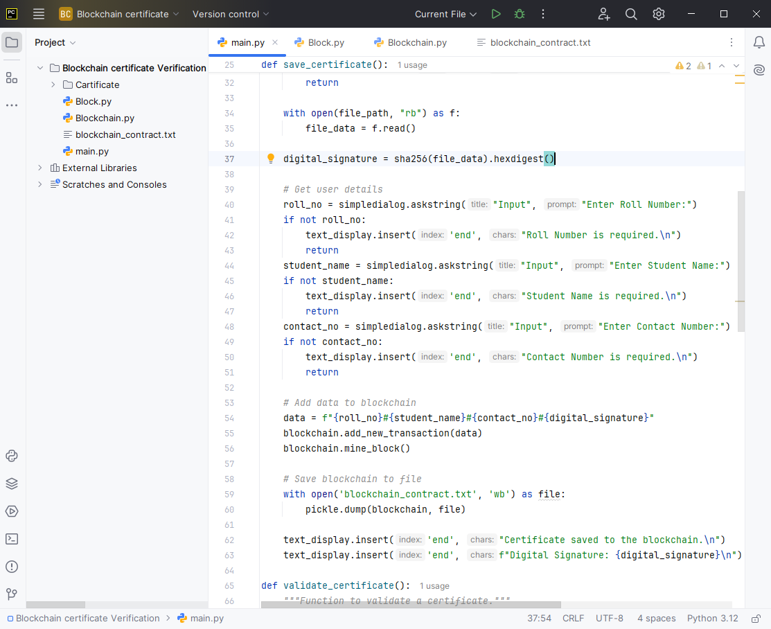
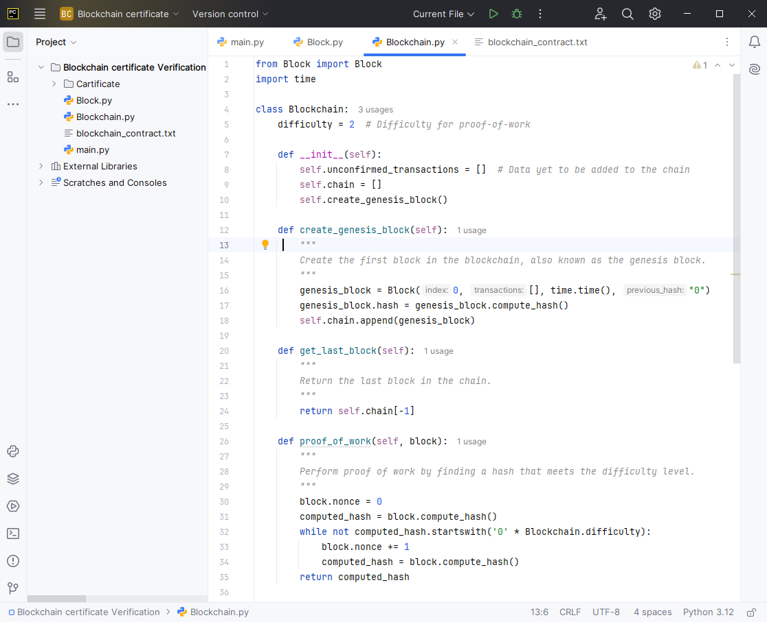
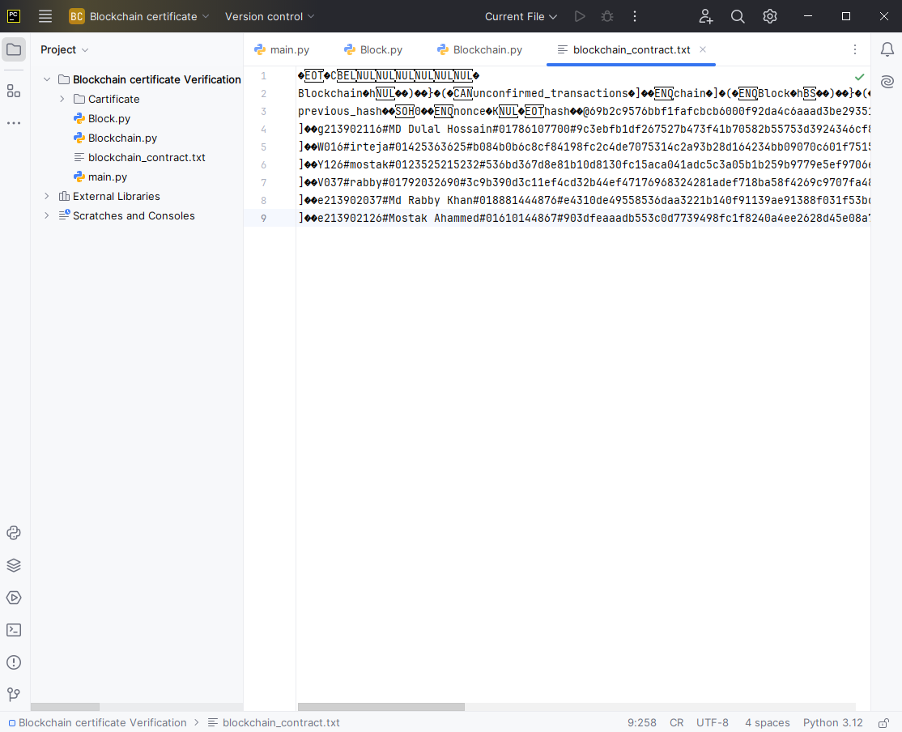
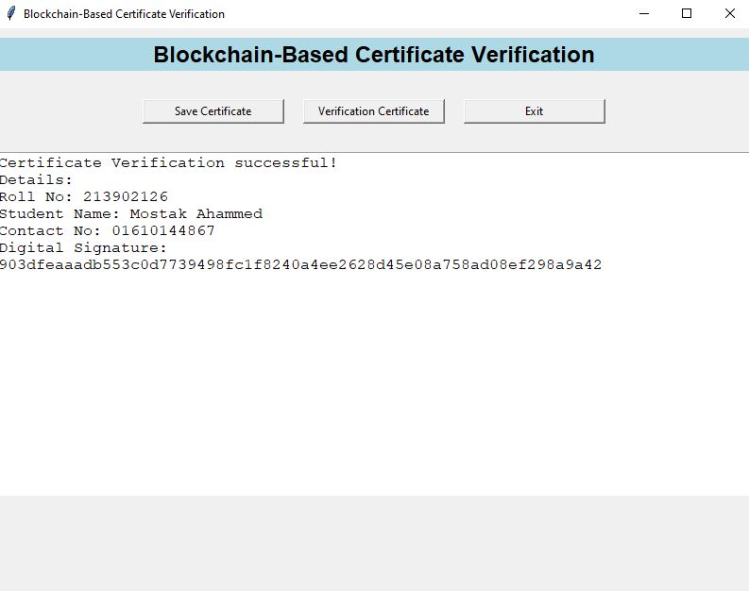
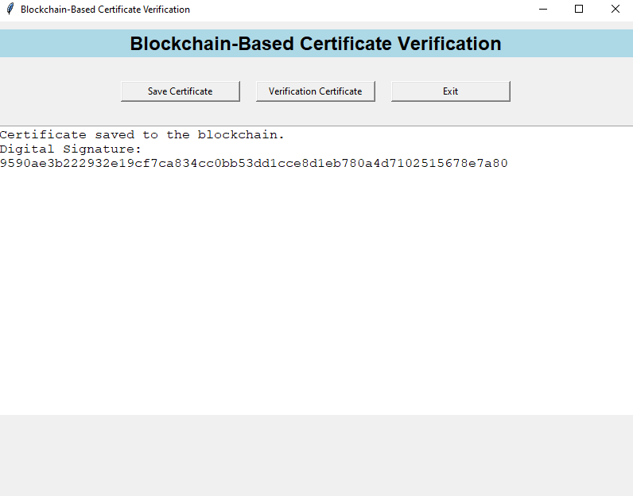
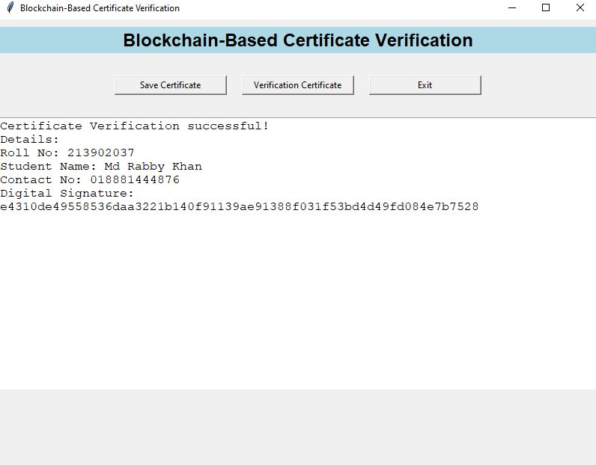
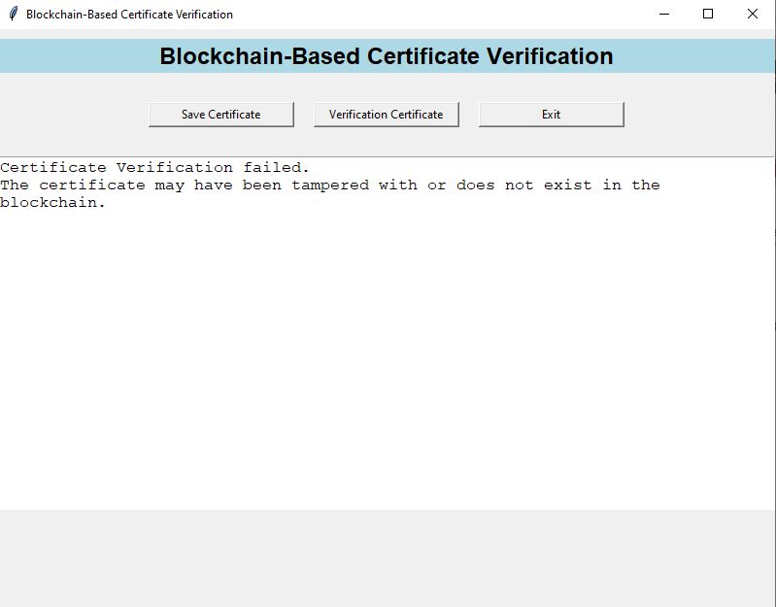
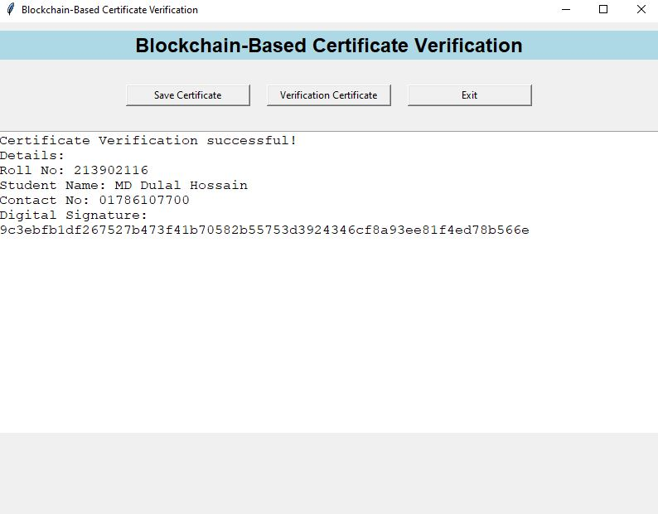
Implementation (2/2)
19

Slide 22
Conclusion
Blockchain makes certificate validation secure and reliable.
Prevents fraud and ensures certificates are tamper-proof.
Saves time by reducing verification from days to minutes.
Simplifies the process, making it more efficient and trustworthy.
Supports global standards for education systems.
Although challenges like cost and scalability exist, continued research will improve the system and make it widely usable in the future.
20

Slide 23
Reference
[1] A Systematic Literature Review on Blockchain-Based Systems for Academic Certificate Verification (2022) DOI: 10.1109/ACCESS.2023.3289598
[2] Blockchain and IoT for Educational Certificates Generation and Verification (2023) DOI: 10.1109/ICCIT52419.2022.9711656
[3] Blockchain-Based IoT Access Control System Towards Security, Lightweight, and Cross-Domain (2021) DOI: 10.1109/ACCESS.2021.3059863
[4] Blockchain-Based AI-Enabled Industry 4.0 CPS Protection Against Advanced Persistent Threats (2023) DOI: 10.1109/JIOT.2022.3147186
[5] A Decentralized Lightweight Blockchain-Based Authentication Mechanism for IoT Systems (2022) DOI: 10.1007/s10586-020-03058-6
21

Slide 24
Thank You
Keep Learning, Keep Grinding

Slide 25

Are There Any Questions,,,

